Slide 1

Don’t Buy a Lemon!
By Richard Fox & Anisha Kunnel

Slide 2

What is Carvana?
Online Used Car Dealer
Founded in 2012
Entire car buying process is online
Purchase all vehicles at used-car auctions
12.8% of purchased cars are defective

Slide 3
How does a used-car Auction work?
2-3 minutes to inspect a car
Cannot test drive it or turn it on
Receive basic information about car
Receive market prices (auction and retail)

Slide 4
Data Mining Objective
Produce a model that outputs probability that a car will be defective
Not looking to automate the process, but aid buyers at auctions

Slide 5
Data Understanding
Received data from Kaggle competition
About 73,000 instances
32 attributes

Slide 6
Data Preparation – Feature Selection
Python script to transform attributes
Information Gain ranker method to evaluate relevant attributes
A lot were useless and many of them showed signs of over fitting (ie. Model name or trim)

Slide 7
Data Preparation – Feature Creation
Created 5 different features
Adjusted Odometer
Take into account age
Difference in market prices from purchase to current time, adjusted by age of vehicle
Ran Information Gain ranker to confirm the value of these attributes
Notes:
Important to note that the reason we accounted for vehicle age was that a pure price shouldn’t predict a bad car.
Adjusted odometer is better than the pure odometer because it better represents strain on the vehicle over the years.

Slide 8
Data Preparation – Feature Creation
Out of 32 original, only used 8
Adjusted Odometer
Age of Vehicle
Wheel Type
4 Price features

Slide 9
Model Creation
When outputting probability what model should you use?
Logistic Regression
Naïve Bayes
Decision Tree
SVM
Each have pros and cons

Slide 10
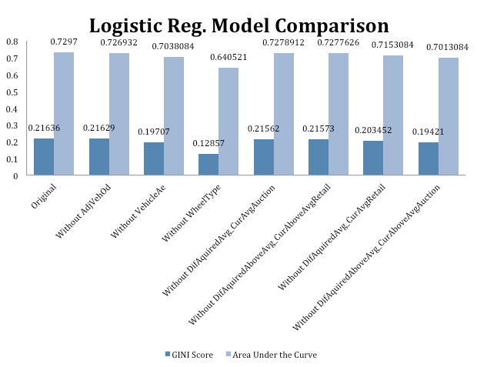
Model Creation – Logistic Reg.
Used R, specifically glm Package
Used all 7 attribute at first and then tested with different feature sets
Tested different linking functions (Probit v. Logit)

Slide 11
Model Creation – Naïve Bayes
Used e1071 Package in R
Gini Score was 0.21774
Higher than logistic regression
Tested laplace correction but had no effect

Slide 12
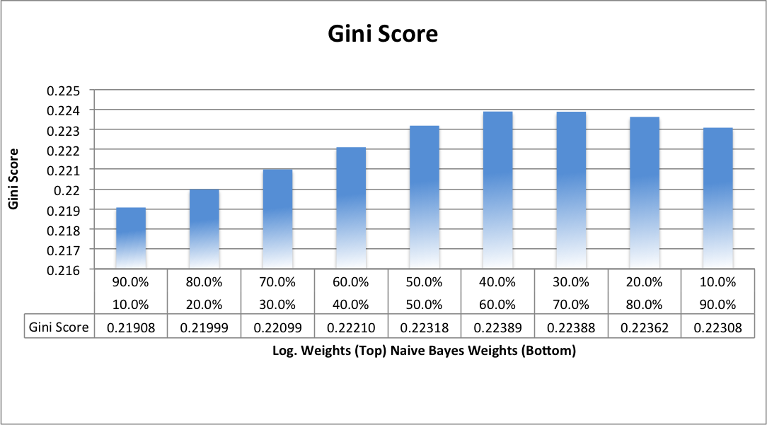
Model Creation – Ensemble Model
No Free Lunch Theorem
Corrects biases that Naïve Bayes and Logistic make
Naïve Bayes’s probability estimates are skewed towards [0,1]
Logistic Regression cannot handle null values, but Naïve Bayes can
By averaging estimates we achieved higher Gini Score

Slide 13
Evaluation – Pre Deployment
Cannot use accuracy, precision, true positive, etc. since they use a cutoff point
Instead used Gini score:
Gini = (2 * AUC ) - 1

Slide 14
Evaluation – Post-Deployment
Domain validation
Test base rate pre and post deployment

Slide 15
Deployment
Real Time estimates
Needs to Mobile so we used iPad as example
Needs to only be an aid to buyers

Slide 16
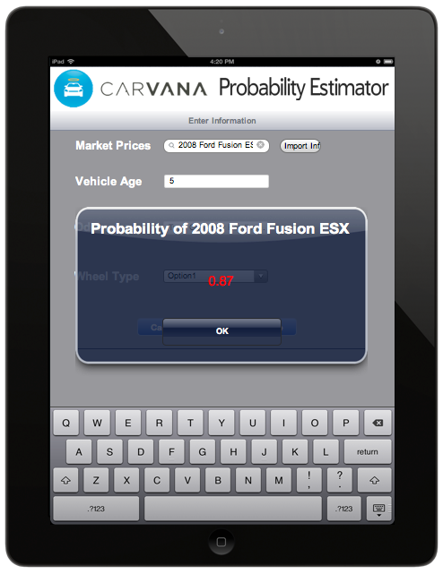
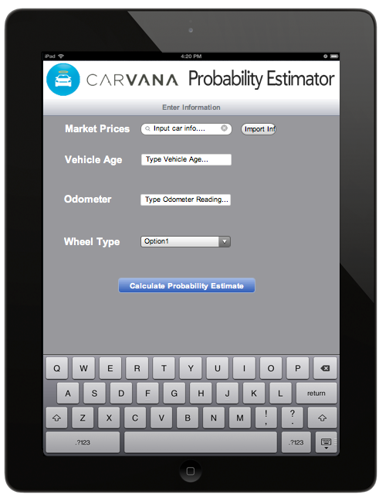

Slide 17
Risks

Slide 18
Questions?

